Slide 1
SharePoint Online Information Protection and Data Loss Prevention
Speaker Name

Slide 3
Objectives
After completing this section, you will:

Slide 4
Know your data – Sensitive Information Types

Slide 5
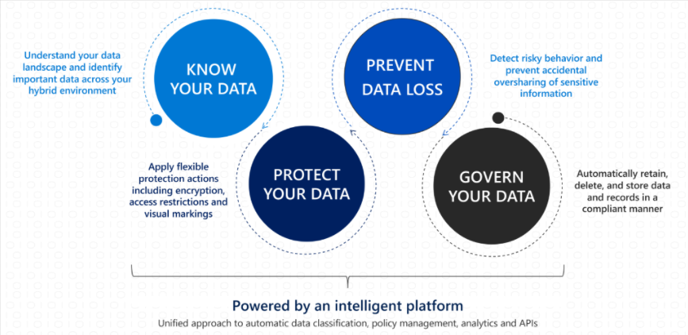

Slide 6
Sensitive information types
Sensitive information types are pattern-based classifiers that detect sensitive information like social security, credit card, or bank account numbers, in order to identify sensitive items
Microsoft 365 provides three ways of identifying items so that they can be classified:
manually by users
automated pattern recognition, like sensitive information types
machine learning

Slide 7
Usage
Sensitive information types are used in
Data loss prevention policies
Sensitivity labels
Retention labels
Insider risk management
Communication compliance
Auto-labelling policies
Privacy management (preview)

Slide 8
Fundamental parts of a sensitive information type
Name: how the sensitive information type is referred to
Description: describes what the sensitive information type is looking for
Pattern: A pattern defines what a sensitive information type detects. It consists of the following components
Primary element – the main element that the sensitive information type is looking for. It can be a regular expression with or without a checksum validation, a keyword list, a keyword dictionary, or a function.
Supporting element – elements that act as supporting evidence that help in increasing the confidence of the match.
For example, keyword “SSN” in proximity of an SSN number. It can be a regular expression with or without a checksum validation, keyword list, keyword dictionary.
Confidence Level - Confidence levels (high, medium, low) reflect how much supporting evidence was detected along with the primary element.
The more supporting evidence an item contains, the higher the confidence that a matched item contains the sensitive info you're looking for.
Proximity – Number of characters between primary and supporting element

Slide 9
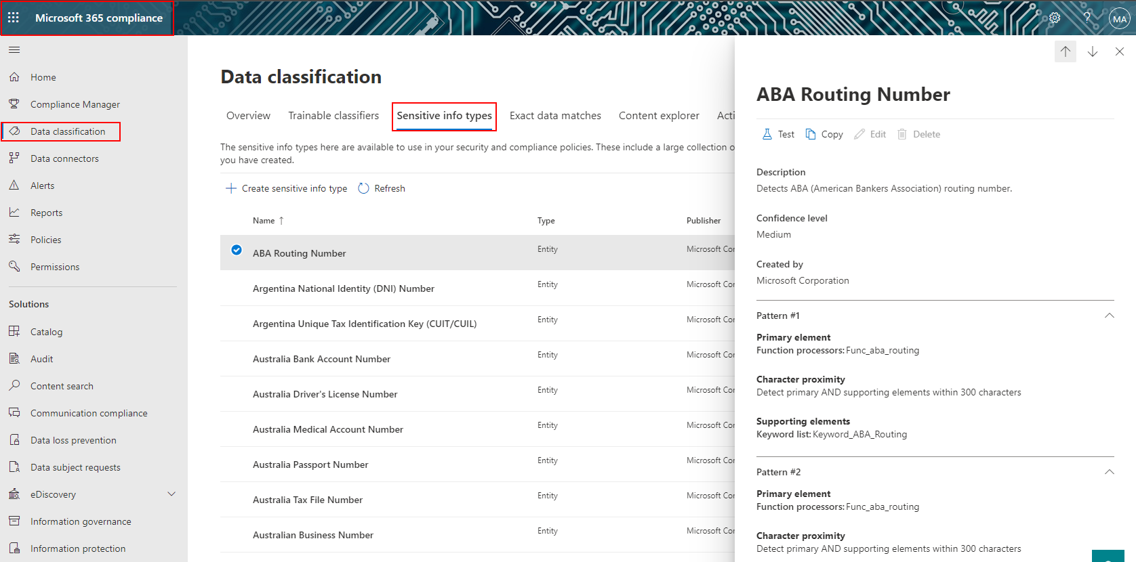
Sensitive Info types
M365 Compliance Center provides over 200 sensitive information types
Existing OOB sensitive info types can be copied and modified as needed
New types can be created from scratch
Available for M365 E3 and up subscriptions

Slide 10
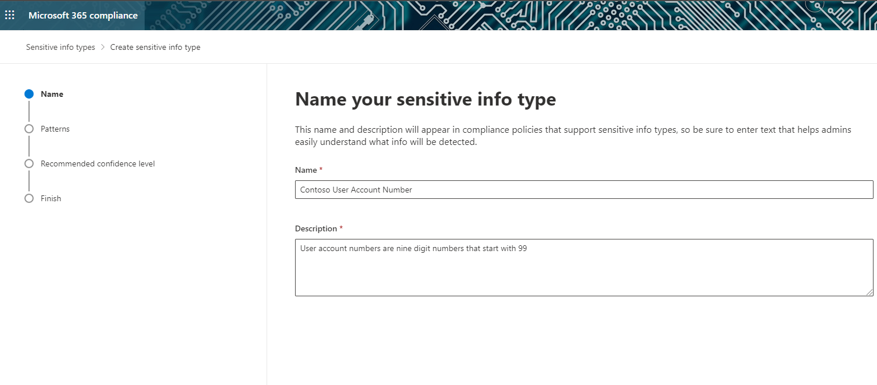
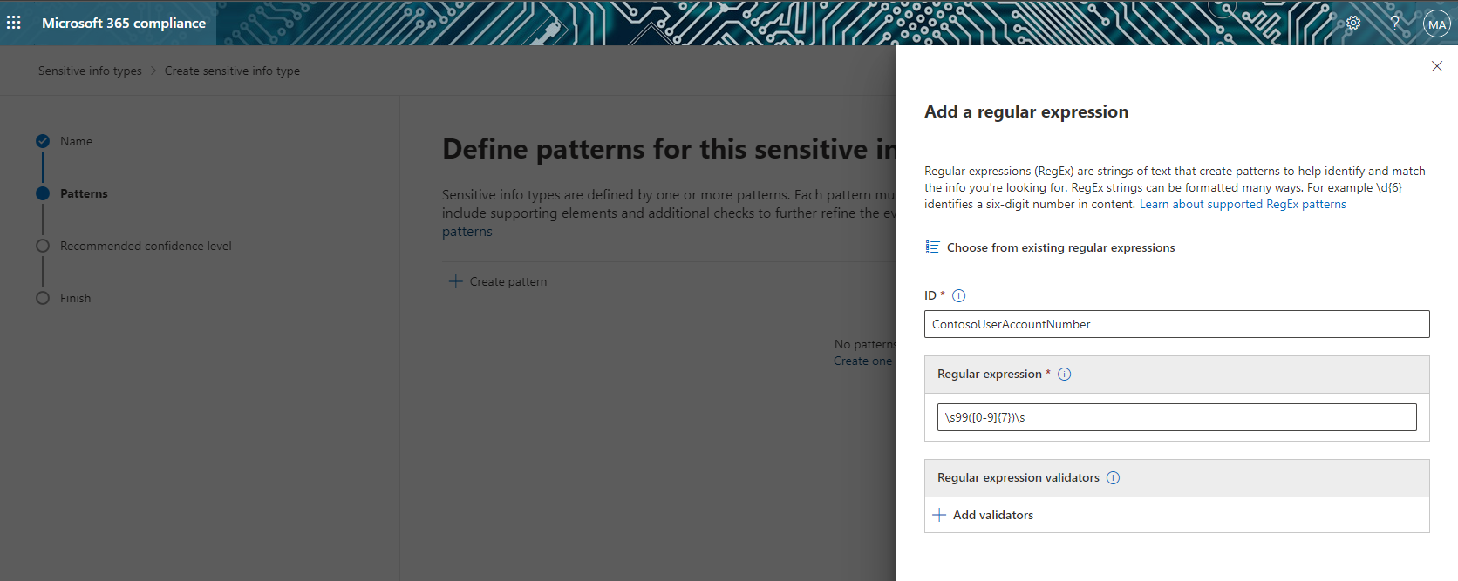
Setting up new sensitive info type
For example, Contoso User Account Numbers.
All Contoso user account numbers are nine-digit numbers that start with 99
Create a new sensitive information type using RegEx pattern \s99([0-9]{7})\s
Find all content in SPO/ODFB that contains User Account Numbers

Slide 11
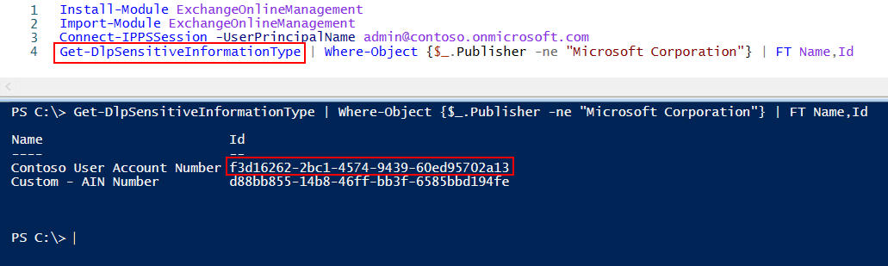
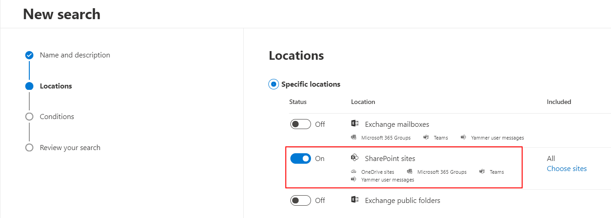
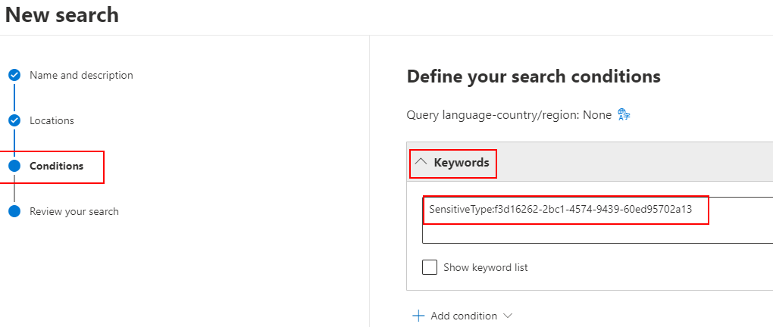
Create new sensitive info type with PS
Use Security & Compliance PowerShell (part of the Exchange Online Management shell module) Get-DlpSensitiveInformationType cmdlet to get ID of the custom sensitive information type
Open Content Search in the M365 Compliance Center and create a new search
Select SharePoint sites (which includes ODFB, M365 groups, Teams and Yammer content that’s stored in SPO sites)
For the Conditions, set Keywords to SensitiveType:f3d16262-2bc1-4574-9439-60ed95702a13
We’re using the ID of the information type that we obtained from PowerShell (Using the ID versus Name is required for all custom sensitive information types
Run the Content search in M365 Compliance center to generate a report of the content in SPO/ODFB that contains Contoso user account numbers
Notes:
Microsoft 365 uses the search crawler to identify and classify sensitive information in SharePoint Online and OneDrive for Business sites. To identify your new custom sensitive information type in existing content, the content must be re-crawled. Content is crawled based on a schedule, but you can manually re-crawl content for a site collection, list, or library. For more information, see Manually request crawling and re-indexing of a site, a library or a list.

Slide 12
Identifying Sensitive Information Types in SharePoint content
Microsoft 365 uses the search crawler to identify and classify sensitive information in SharePoint Online and OneDrive for Business sites.
To identify your new custom sensitive information type in existing content, the content must be re-crawled.
Content is crawled based on a schedule, but you can manually re-crawl content for a site collection, list, or library.
For more information see Manually request crawling and re-indexing of a site, a library or a list.

Slide 13
Labels

Slide 14
Labels - overview
Different types of content may require different types for retention actions taken on them:
Tax forms that need to be retained for a minimum period of time.
Press materials that need to be permanently deleted when they reach a certain age.
Competitive research that needs to be both retained and then permanently deleted.
Work visas that must be marked as a record so that they can’t be edited or deleted.
Different types of sensitive content may require additional protections applied on them:
Apply a Confidential label to a document and that label can encrypt the content and apply a Confidential watermark.
Sensitivity labels that work in Office apps on Windows, Mac, iOS, and Android. Support for Office web apps is coming soon..
Prevent sensitive content from leaving your organization on devices running Windows, by using endpoint protection in Microsoft Intune.

Slide 15
Retention Labels and Sensitivity Labels
Retention Labels can provide the following functions
Retention
Deletion
Records Management
Archiving
Sensitivity Labels can provide the following functions:
Encrypt
Restrict Access
Watermark
Header/footer

Slide 16
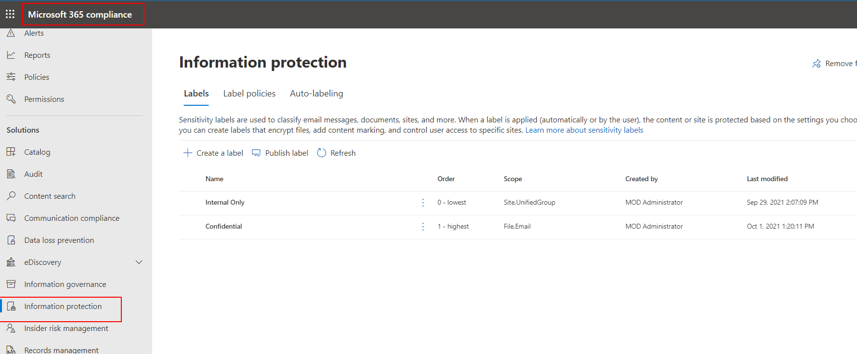
The Microsoft 365 Compliance Center
Use the M365 Compliance Center – Information Protection to create and publish Sensitivity labels
Setup label policies
Setup Auto-labeling
Notes:
The Microsoft 365 security and compliance center is rolling out now. Once deployed, administrators can login as they usually do, or navigate to https://protection.microsoft.com to try out the new security and compliance experiences. In addition, they can also navigate to the Microsoft 365 security and compliance center from the Microsoft 365 admin center .
See https://techcommunity.microsoft.com/t5/Security-Privacy-and-Compliance/Introducing-the-Microsoft-365-Security-and-Compliance-Center/ba-p/178468
The features and settings available in the M365 CC depend on the level of Microsoft 365, Azure Premium, and Enterprise Mobility + Security, subscriptions you have
For more information on Security and Compliance Center features see
https://docs.microsoft.com/en-us/office365/servicedescriptions/office-365-platform-service-description/office-365-securitycompliance-center#security--compliance-center-availability-for-standalone-plans
Data governance enables users to create, publish, and manually apply labels to documents; import data using drive shipping or over the network; and create and apply retention/deletion policies across workloads, users, and groups. Retention policies applied to mailboxes require Microsoft 365 Enterprise E3 or E5.
Advanced data governance allows you to retain important information and delete unimportant information by classifying information based on a retention or deletion policy or both. It includes intelligent/automated actions such as recommending policies, automatically applying labels to data, applying labels based on sensitive data types or queries, disposition review, and use of smart import filters.
Advanced eDiscovery is supported in the United States and in the Western Europe (Netherlands) region. (Customer data from Canada and Asia Pacific is exported to the United States. Customer data from Europe, the Middle East, and Africa is exported to Western Europe [Netherlands].)
Advanced Threat Protection is available in Microsoft 365 Enterprise E5 and as a standalone service for Microsoft 365 Enterprise E1 and Microsoft 365 Enterprise E3.

Slide 17
Sensitivity Labels

Slide 18
Sensitivity labels
In many use cases, people within your organization will need to collaborate with others both inside and outside the organization.
This means that content no longer stays behind a firewall
It can roam everywhere, across devices, apps, and services.
When content roams, you want it to do so in a secure, protected way that meets your organization's business and compliance policies.
Microsoft Information Protection Sensitivity labels provide the ability to classify and protect your organization's data while making sure that user productivity and their ability to collaborate isn't hindered.

Slide 19
You can use Sensitivity labels to:
Provide protection settings that include encryption and content markings.
For example, apply a "Confidential" label to a document, and that label encrypts the content and applies a "Confidential" watermark.
Content markings include headers and footers as well as watermarks, and encryption can also restrict what actions authorized people can take on the content.
Protect content in Office apps across different platforms and devices
Supported by Word, Excel, PowerPoint, and Outlook on the Office desktop apps and Office on the web. Supported on Windows, macOS, iOS, and Android.
Protect containers that include SharePoint sites, Teams, and Microsoft 365 Groups
For example, set privacy settings, external user access and external sharing, and access from unmanaged devices.
Classify content without using any protection settings.
This provides users with a visual mapping of classification to your organization's label names
Can use the labels to generate usage reports and see activity data for your sensitive content. Based on this information, you can always choose to apply protection settings later.

Slide 20
Sensitivity Labels – Process flow
Admin
Creates a sensitivity label
Publish the sensitivity label to users and groups selected in a label policy
End User
Works on a document in SPO/ODFB and sees the available labels
Classifies the document by applying a label
Office or third-party app/service
Enforces protection settings on the email or document based on the applied label

Slide 21
Enable sensitivity labels for Office files in SharePoint and OneDrive
SPO Admins can enable built-in labeling for supported Office files in SharePoint and OneDrive
Enabling this feature results in SharePoint and OneDrive being able to process the contents of Office files that have been encrypted by using a sensitivity label.
Sensitivity labels can be applied in Office for the web, or in Office desktop apps, and uploaded or saved in SharePoint and OneDrive.
Until you enable this feature, SharePoint and OneDrive can't process encrypted files, which means that coauthoring, eDiscovery, Data Loss Prevention, search, and other collaborative features won't work for these files.

Slide 22
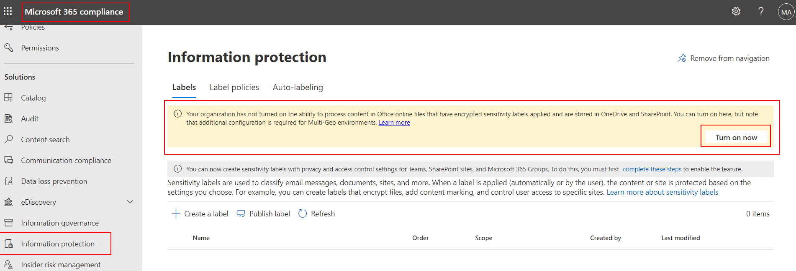
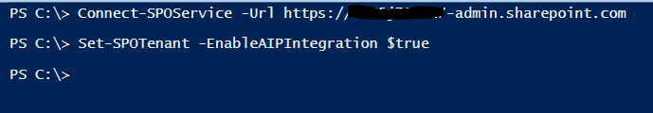
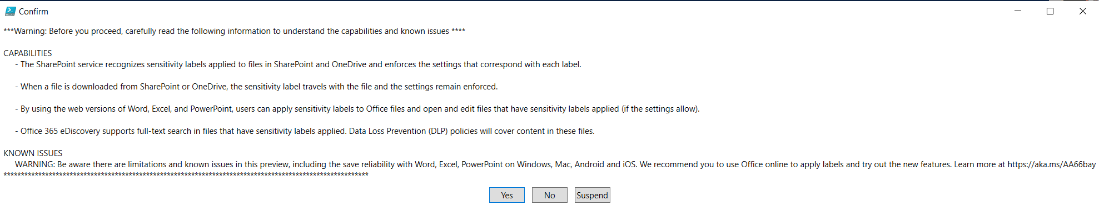
Enabling sensitivity labels for SPO and ODFB
Use the compliance center to enable support for sensitivity labels
Use PowerShell to enable support for sensitivity labels
Set-SPOTenant cmdlet with the EnableAIPIntegration parameter
To disable sensitivity labels for SharePoint and OneDrive you must use PowerShell
Set-SPOTenant -EnableAIPIntegration $false

Slide 23
Publishing and changing sensitivity labels
Newly created or updated sensitivity labels with SharePoint and OneDrive, require time for replication, you might not see them right away .
This is especially important for new labels that apply encryption.
The following replicates within 1 hour:
New and deleted sensitivity labels
Sensitivity label policy settings that include labels in the policy.
The following replicates within 24 hours:
Changes to sensitivity label settings for existing labels
We recommend publishing new labels to just a few test users first, wait for an hour, and then verify the label behavior in SharePoint and OneDrive.
As the final step, make the label available to more users by either adding more users to the existing label policy, or add the label to an existing label policy for your standard users.
At the time your standard users see the label, it has already synchronized to SharePoint and OneDrive.

Slide 24
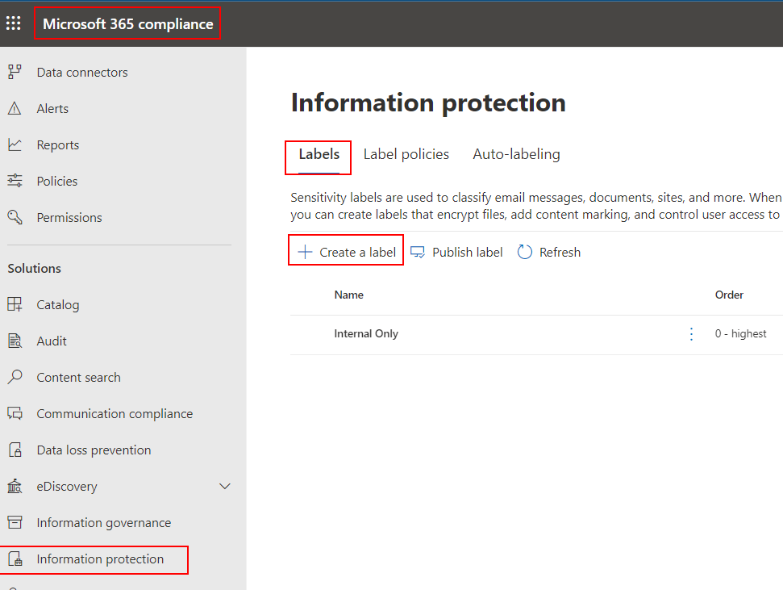
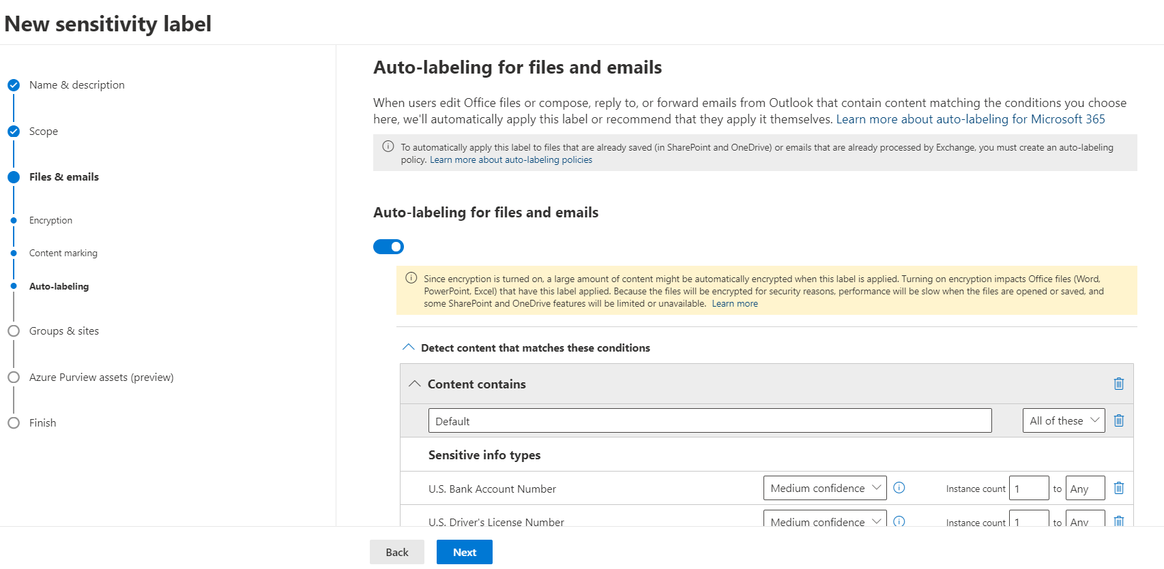
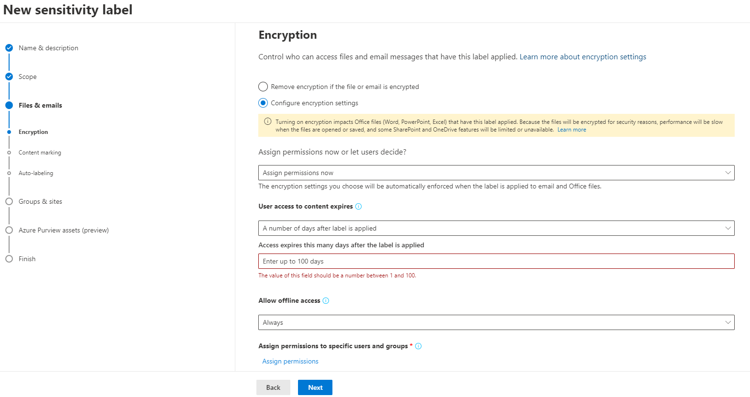
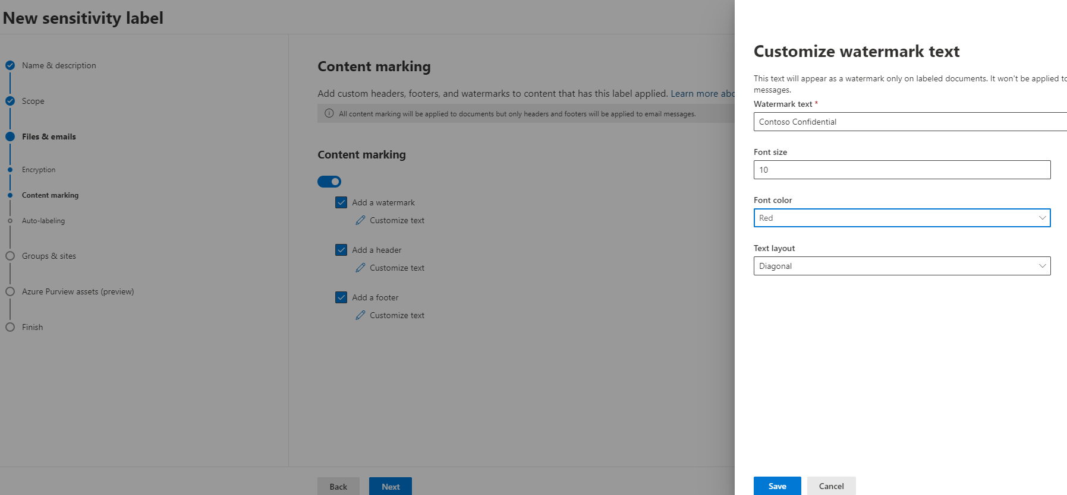
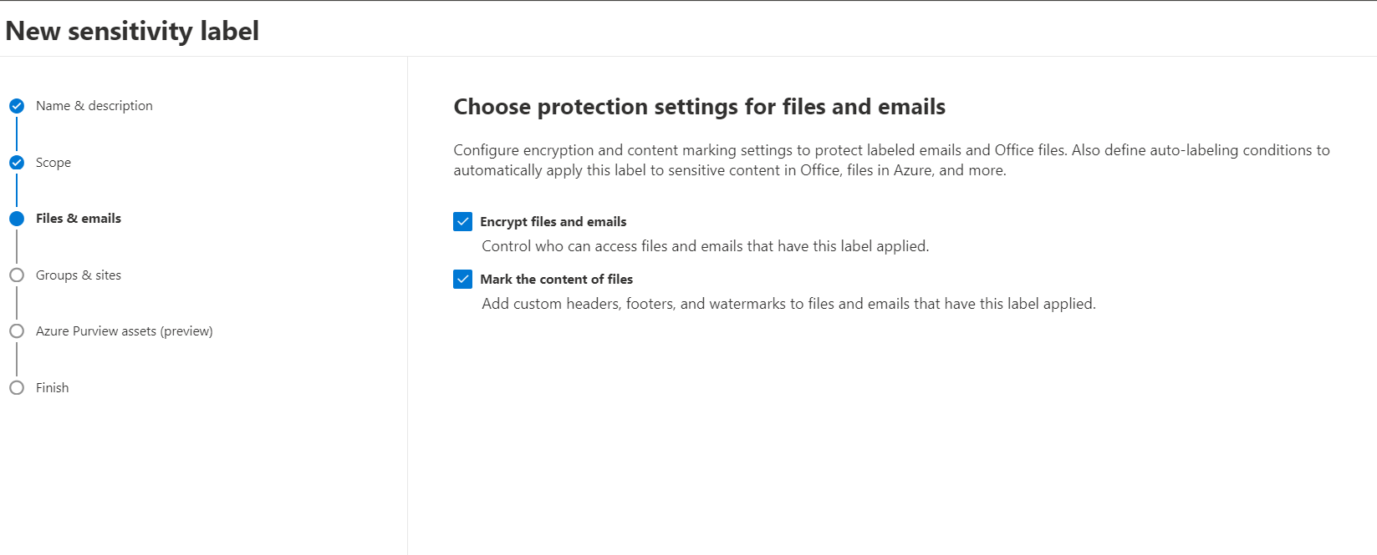
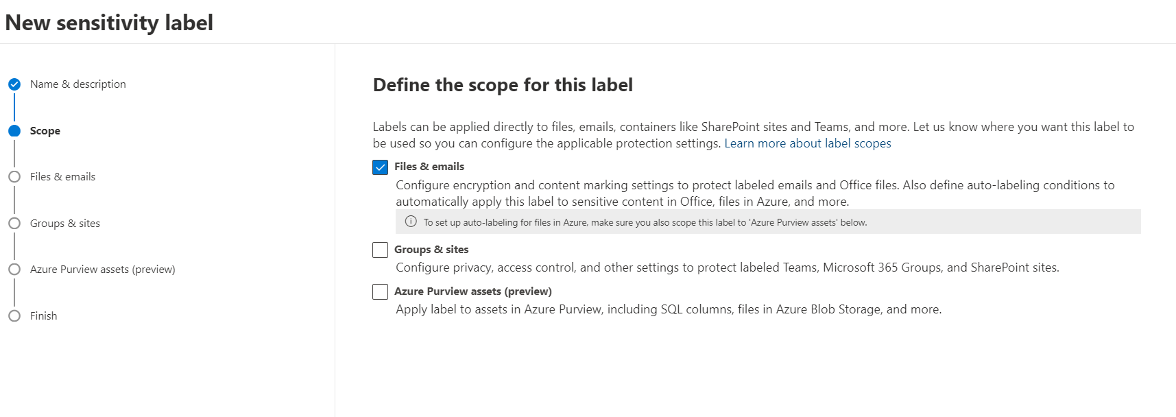
Create Sensitivity label for documents in SharePoint
Sensitivity labels are created and managed in the M365 Compliance Center
To create a new label for documents stored in SPO/ODFB, set the scope to Files & emails
Choose Protection settings for files
Encryption settings
Content markings
Auto labeling
Configure conditions to detects content that contains specific sensitive information
Auto-apply Sensitivity labels requires additional licensing for E3 users
Notes:
NOTE! Microsoft 365 E5/A5/G5, Microsoft 365 E5/A5/G5/F5 Compliance and F5 Security & Compliance, Microsoft 365 E5/A5/G5 Information Protection and Governance, Office 365 E5, Enterprise Mobility + Security E5/A5/G5, and AIP Plan 2 provide the rights for a user to benefit from automatic sensitivity labeling.
https://docs.microsoft.com/en-us/office365/servicedescriptions/microsoft-365-service-descriptions/microsoft-365-tenantlevel-services-licensing-guidance/microsoft-365-security-compliance-licensing-guidance#which-licenses-provide-the-rights-for-a-user-to-benefit-from-the-service-10
Considerations for encrypted content
Encrypting your most sensitive documents and emails helps to ensure that only authorized people can access this data. However, there are some considerations to take into account:
If your organization hasn't enabled sensitivity labels for Office files in SharePoint and OneDrive:
Search, eDiscovery, and Delve will not work for encrypted files.
DLP policies work for the metadata of these encrypted files (including retention label information) but not the content of these files (such as credit card numbers within files).
Users can't open encrypted files using Office on the web. When sensitivity labels for Office files in SharePoint and OneDrive are enabled, users can use Office on the web to open encrypted files, with some limitations that include encryption that has been applied with an on-premises key (known as "hold your own key", or HYOK), double key encryption, and encryption that has been applied independently from a sensitivity label.
If you share encrypted documents with people outside your organization, you might need to create guest accounts and modify Conditional Access policies. For more information, see Sharing encrypted documents with external users.
When authorized users open encrypted documents in their Office apps, they see the label name and description in a yellow message bar at the top of their app. When the encryption permissions extend to people outside your organization, carefully review the label names and descriptions that will be visible in this message bar when the document is opened.
For multiple users to edit an encrypted file at the same time, they must all be using Office for the web. Or, for Windows and Mac, you have enabled co-authoring for files encrypted with sensitivity labels and users have the required minimum versions of Word, Excel, and PowerPoint. If this isn't the case, and the file is already open:
In Office apps (Windows, Mac, Android, and iOS), users see a File In Use message with the name of the person who has checked out the file. They can then view a read-only copy or save and edit a copy of the file, and receive notification when the file is available.
In Office for the web, users see an error message that they can't edit the document with other people. They can then select Open in Reading View.
The AutoSave functionality in Office apps for iOS and Android is disabled for encrypted files. This functionality is also disabled for encrypted files on Windows and Mac if you haven't enabled co-authoring for files encrypted with sensitivity labels. Users see a message that the file has restricted permissions that must be removed before AutoSave can be turned on.
Encrypted files might take longer to open in Office apps (Windows, Mac, Android, and iOS).
If a label that applies encryption is added by using an Office app when the document is checked out in SharePoint, and the user then discards the checkout, the document remains labeled and encrypted.
The following actions for encrypted files aren't supported from Office apps (Windows, Mac, Android, and iOS), and users see an error message that something went wrong. However, SharePoint functionality can be used as an alternative:
View, restore, and save copies of previous versions. As an alternative, users can do these actions using Office on the web when you enable and configure versioning for a list or library.
Change the name or location of files. As an alternative, users can rename a file, folder, or link in a document library in SharePoint.

Slide 25
Sensitivity Label Policies and Locations
If the label is… | Then the label policy can be applied to…
Published to end users | Users and Groups Label is the available to users to manually apply to documents
* Auto-applied based on sensitive information types | Based on a Condition that is based on Sensitive data types Uses the same list of sensitive information types that are used to create a data loss prevention (DLP) policy
Sensitivity Labels are published to Users/Groups (vs. location)
Users access Sensitivity Labels in their apps and services based on who they are, rather then retention labels that are accessed based on site or location
Auto-apply Sensitivity labels requires additional licensing for E3 users
Notes:
Auto-apply Sensitivity labels requires Microsoft 365 E5/A5/G5, Microsoft 365 E5/A5/G5/F5 Compliance and F5 Security & Compliance, Microsoft 365 E5/A5/G5 Information Protection and Governance, Office 365 E5, Enterprise Mobility + Security E5/A5/G5, and AIP Plan 2 provide the rights for a user to benefit from automatic sensitivity labeling. https://docs.microsoft.com/en-us/office365/servicedescriptions/microsoft-365-service-descriptions/microsoft-365-tenantlevel-services-licensing-guidance/microsoft-365-security-compliance-licensing-guidance#which-licenses-provide-the-rights-for-a-user-to-benefit-from-the-service-10
You can choose to apply sensitivity labels to content automatically when that content contains specific types of sensitive information. When you configure a sensitivity label to be applied automatically, you see the same list of sensitive information types as when you create a data loss prevention (DLP) policy

Slide 26
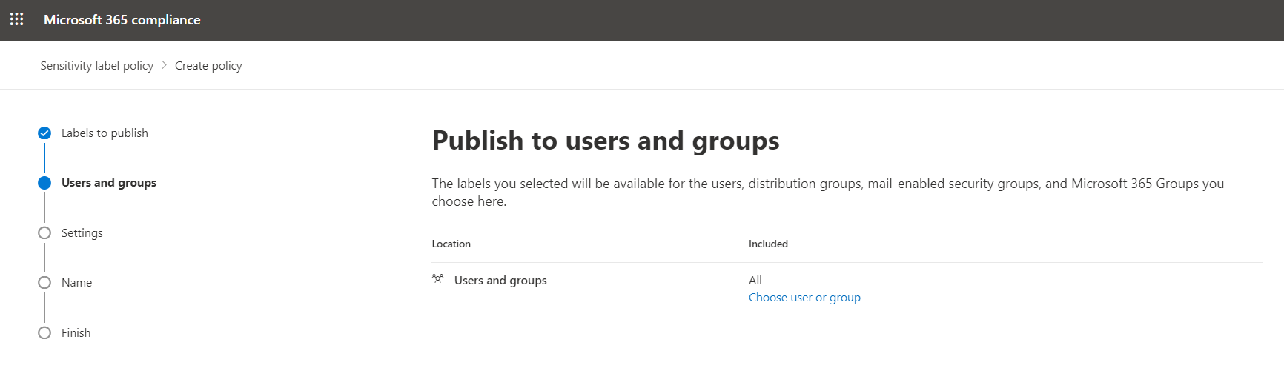
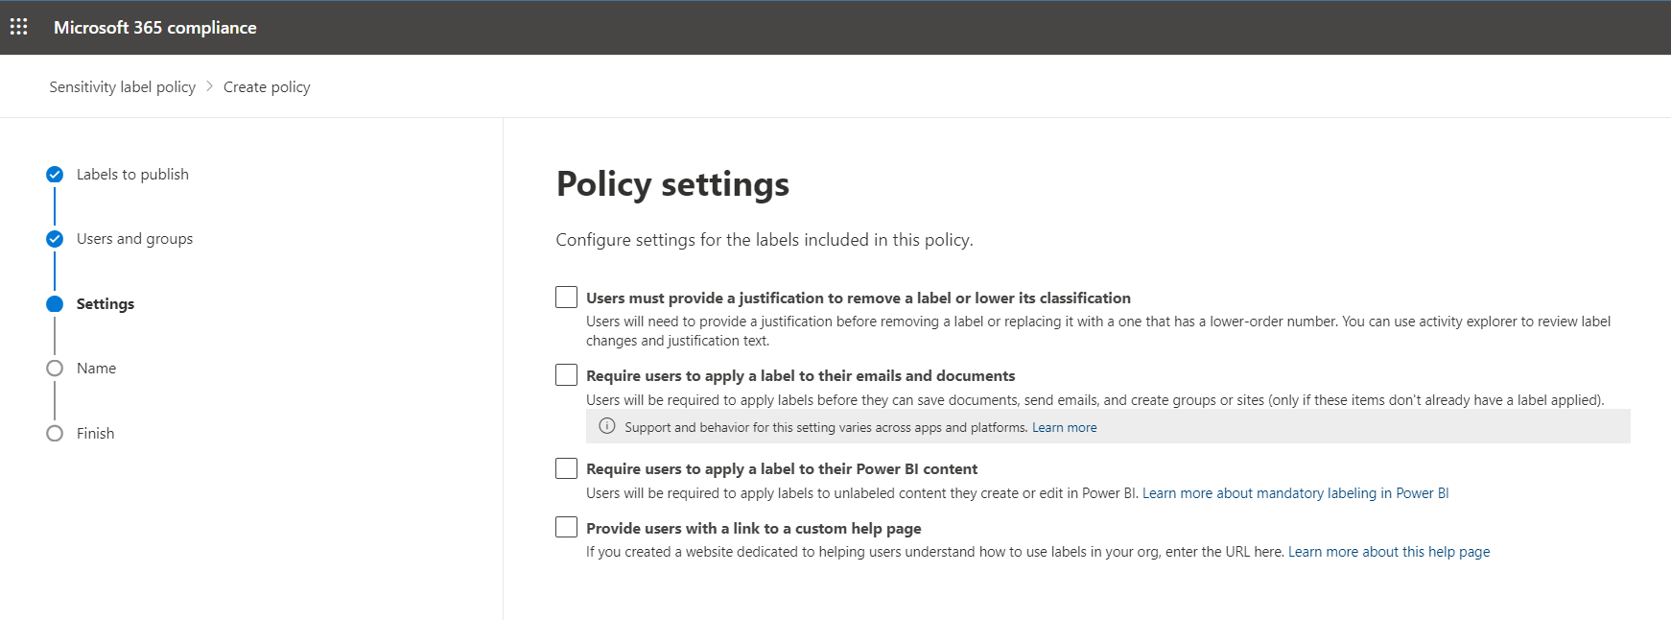
Publish Sensitivity label

Slide 27
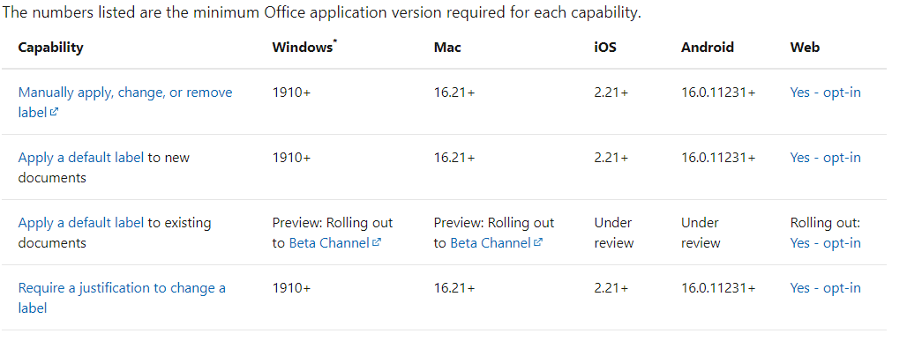
Built-in Sensitivity label capabilities in Word, Excel, and PowerPoint

Slide 28
Azure Information Protection – Unified labeling client
Built-in labeling is not included in older versions of Office (Office 2016, 2019)
The Azure Information Protection Unified Labeling Client office add-on is required in order to use sensitivity labels with older Office client apps
The Azure Information Protection Unified Labeling Client can also be added to newer versions of Office that do include built-in labeling in order to obtain additional label features and functionality
For a complete feature comparison between labeling clients see https://docs.microsoft.com/en-us/azure/information-protection/rms-client/use-client#compare-the-labeling-solutions-for-windows-computers

Slide 29
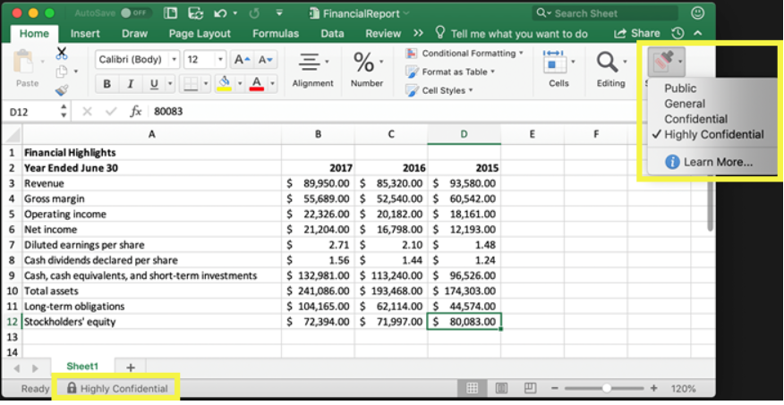
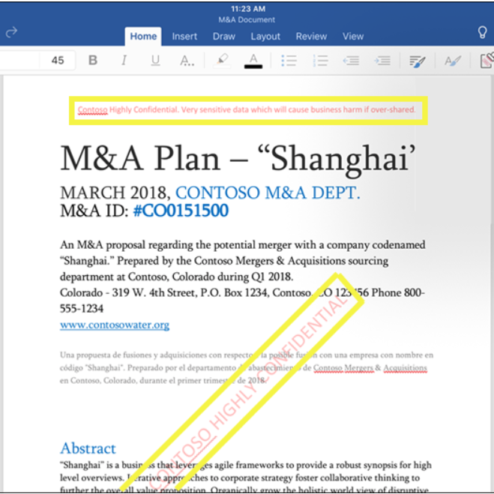
Using sensitivity labels
To apply sensitivity labels, users must be signed in with their Microsoft 365 work or school account.
Sensitivity labels in Office Apps are applied from the Home tab on the Ribbon.
The applied label displays on the status bar
Sensitivity labels can be configured and used to mark content when using Office apps, by adding watermarks, headers, or footers to documents

Slide 30
Sensitivity labels for SharePoint Sites, Teams and M365 Groups
You can also use sensitivity labels to protect the following containers:
SharePoint sites, Microsoft Teams sites, Microsoft 365 groups
Uses the following label settings:
Privacy (public or private) of teams sites and Microsoft 365 groups
External user access
External sharing from SharePoint sites
Access from unmanaged devices
Authentication contexts (in preview)
These container level sensitivity labels automatically apply the classifications and configured protection settings (listed above) to the site or group.
Documents in these containers do not inherit the labels for the classification or settings for files, such as visual markings and encryption.

Slide 31
Enable sensitivity labels for containers and synchronize labels
To apply published labels to sites, you must first enable the feature in Azure AD
Install-Module AzureADPreview Import-Module AzureADPreview Connect-AzureAD $setting = (Get-AzureADDirectorySetting | where -Property DisplayName -Value "Group.Unified" -EQ) $template = Get-AzureADDirectorySettingTemplate -Id 62375ab9-6b52-47ed-826b-58e47e0e304b $setting = $template.CreateDirectorySetting() $Setting.Values $Setting["EnableMIPLabels"] = $true New-AzureADDirectorySetting -DirectorySetting $setting
Then synchronize your sensitivity labels to Azure AD using the Security and Compliance Center PowerShell module
Import-Module ExchangeOnlineManagement Connect-IPPSSession -UserPrincipalName <UPN> [-ConnectionUri <URL>] [-PSSessionOption $ProxyOptions] Connect-IPPSSession –UserPrincipalName <UPN> Execute-AzureAdLabelSync Disconnect-ExchangeOnline

Slide 32
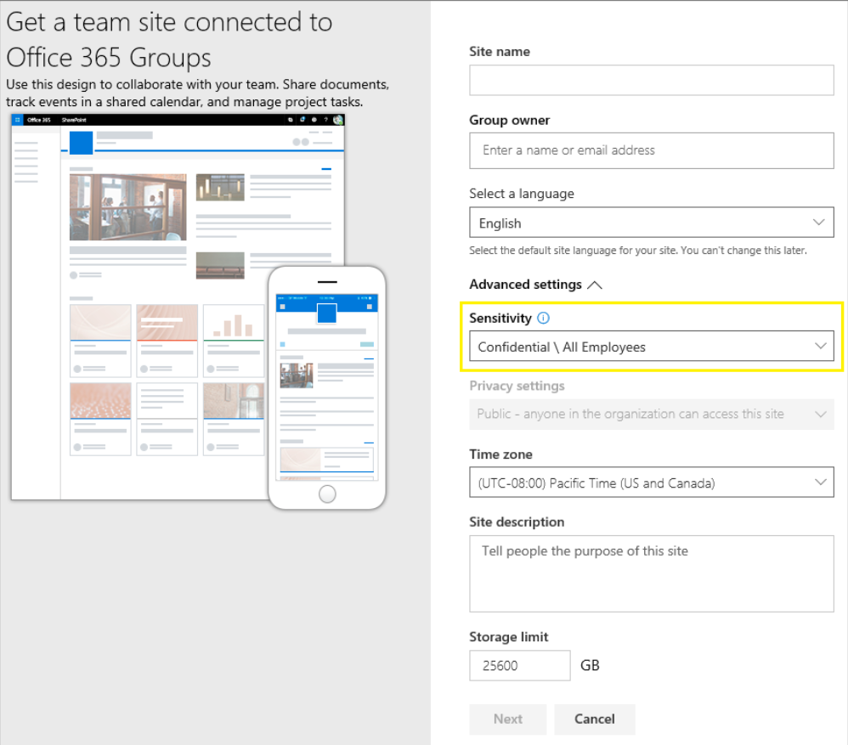
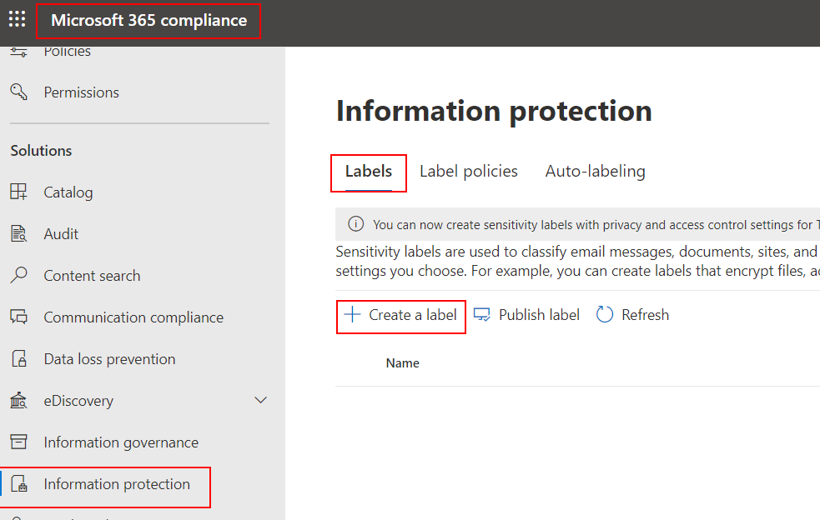
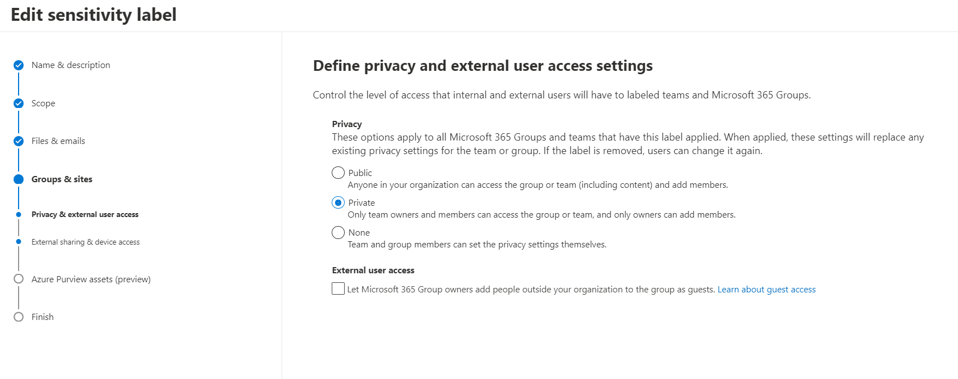
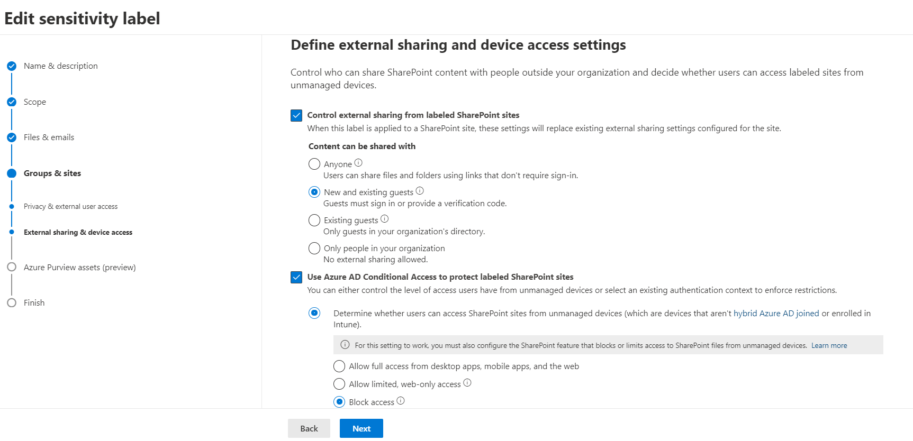
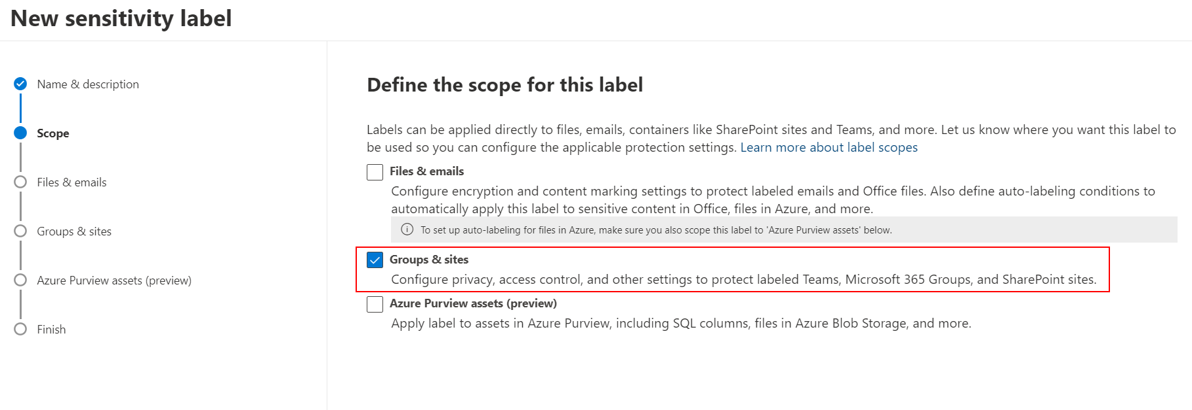
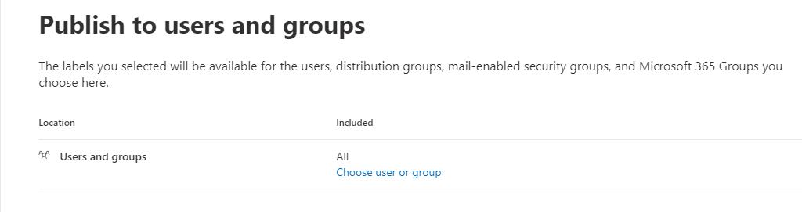
Create and publish labels for sites
Create new label
Set scope to Groups & Sites
Define privacy and external user access settings
Define external sharing and conditional access settings for devices
Determine whether users can access SharePoint sites from unmanaged devices
Publish label
Notes:
Choose an existing authentication context: Currently in preview, this option lets you enforce more stringent access conditions when users access SharePoint sites that have this label applied. These conditions are enforced when you select an existing authentication context that has been created and published for your organization's Conditional Access deployment. If users don't meet the configured conditions or if they use apps that don't support authentication contexts, they are denied access.
For additional configuration information, see More information about the dependencies for the authentication context option at the end of this section. https://docs.microsoft.com/en-us/microsoft-365/compliance/sensitivity-labels-teams-groups-sites?view=o365-worldwide#more-information-about-the-dependencies-for-the-unmanaged-devices-option
Examples for this label configuration:
You choose an authentication context that is configured to require multifactor authentication (MFA). This label is then applied to a SharePoint site that contains highly confidential items. As a result, when users from an untrusted network attempt to access a document in this site, they see the MFA prompt that they must complete before they can access the document.
You choose an authentication context that is configured for terms of use (ToU) policies. This label is then applied to a SharePoint site that contains items that require a terms of use acceptance for legal or compliance reasons. As a result, when users attempt to access a document in this site, they see a terms of use document that they must accept before they can access the original document.

Slide 33
Additional Guidance
See the following page and downloads that you can use for End User Training for Sensitivity Labels Sensitivity Labels - Compliance Customer Experience Engineering (CxE) (microsoft.github.io)
The following provides the rights for a user to benefit from automatic sensitivity labeling.
Microsoft 365 E5/A5/G5
Microsoft 365 E5/A5/G5/F5 Compliance and F5 Security & Compliance
Microsoft 365 E5/A5/G5 Information Protection and Governance
Office 365 E5, Enterprise Mobility + Security E5/A5/G5, and AIP Plan 2

Slide 34
Data Loss Prevention

Slide 35




Data Loss Prevention in Microsoft 365
Microsoft 365 Data Loss Prevention (DLP) allows you to
Identify
Monitor
Protect…
…Sensitive information through deep content analysis and educate end users through their daily workflow.
Identify
Monitor
Protect
End-user education
Notes:
Identify: Sensitive information / deep analysis.
Monitor: Audit the type of content being allowed to exist within the boundary of your organization.
When and where is it going to.
Protect: Once content is detected what protection policies are triggered.
What requirements are applied based on the content found.
Warn
Send message for approval
Block etc.
User Education
Policy tips (advantage over competitors on the market today.
Informs users that message contains sensitive information.
Identifies the source of the content.
Provides additional information linking to business policy content.
All before the user sends the message.

Slide 36
Sensitive Information Types
Examples of sensitive information that you might want to prevent from leaking externally:
Financial Data
Personally Identifiable Information (PII)
Credit Card Numbers
Social Security Numbers
Health Records state
Microsoft 365 comes with > 200 Out Of The Box (OOTB) types spanning 10 countries
Notes:
https://docs.microsoft.com/en-us/office365/securitycompliance/data-loss-prevention-policies?redirectSourcePath=%252fen-us%252farticle%252fOverview-of-data-loss-prevention-policies-1966b2a7-d1e2-4d92-ab61-42efbb137f5e

Slide 37
DLP content detection flow in SharePoint
Detection of sensitive info in SharePoint will not be instant as content must be crawled and processed
Crawler processes info in SharePoint content and feeds it to index for searching
DLP runs in the O365 search content processing pipeline as a Classification operator
Invoked for search crawler as new content discovered and changed
Classification results and counts are stored in the content index
Crawler
DLP content detection flow in SharePoint
Content Processing Component
Index
Delete
item
Index
Delete Links
Document
Parser
Property
Mapping
Language
Detection
Classification
Operator
Word breaking
Custom Entity Extraction
Document summary
Insert new
or updated
item
Excel Format Handler
Ifilter sandbox
Notes:
Crawler – processes info in SharePoint content and feeds it to index for searching; for SPO, this is every 15 min
Content processing – get information properties and transforms it before save in the index, it begins when crawler is started, at this moment DLP is applied
Query component – what the user uses to search for information into the search index ex: keyword
-> it's not instantaneous, it will depends on the crawler that calls the content processing to generate the index, after that the DLP will be applied

Slide 38
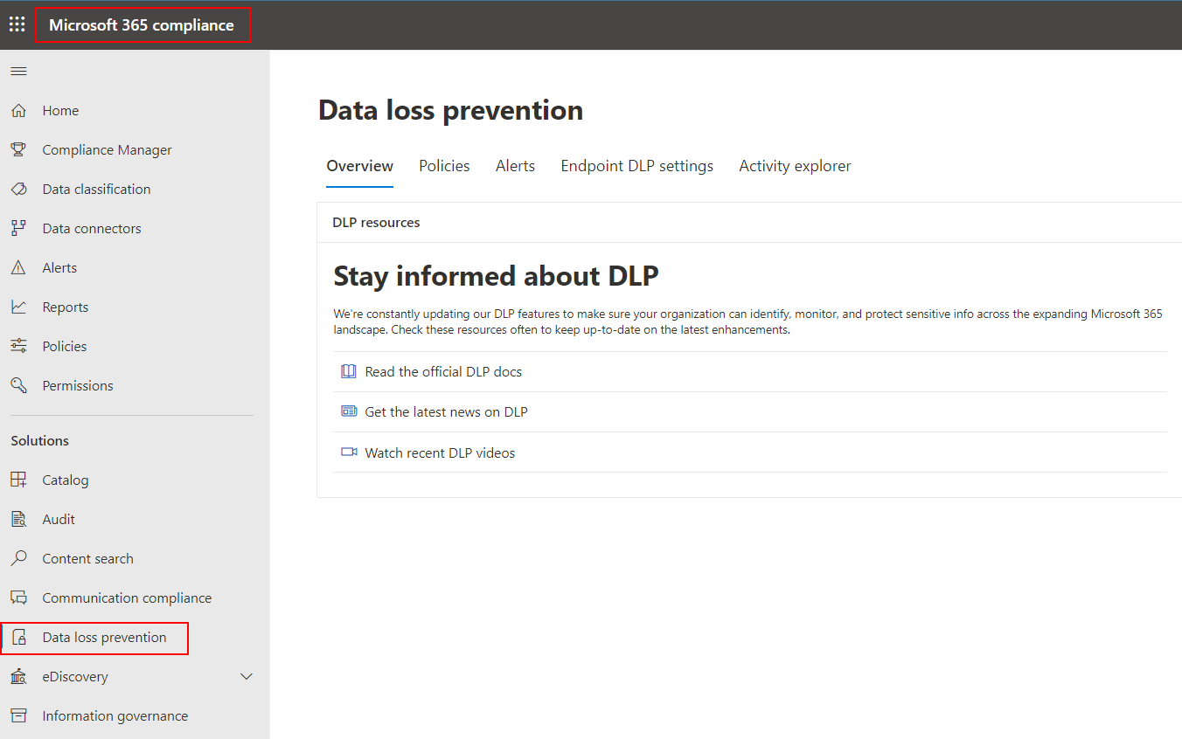
How DLP Policies Work
With a DLP policy, you can:
Identify sensitive information across many locations, such as SharePoint Online, and OneDrive for Business and Exchange Online.
Prevent the accidental sharing of sensitive information internally or externally
Notes:
In Microsoft 365, you implement data loss prevention by defining and applying DLP policies. With a DLP policy, you can identify, monitor, and automatically protect sensitive items across:
Microsoft 365 services such as Teams, Exchange, SharePoint, and OneDrive
Office applications such as Word, Excel, and PowerPoint
Windows 10 endpoints
non-Microsoft cloud apps
on-premises file shares and on-premises SharePoint.
Microsoft 365 detects sensitive items by using deep content analysis, not by just a simple text scan.
Content is analyzed for primary data matches to keywords, by the evaluation of regular expressions, by internal function validation, and by secondary data matches that are in proximity to the primary data match.
Beyond that DLP also uses machine learning algorithms and other methods to detect content that matches your DLP policies.

Slide 39
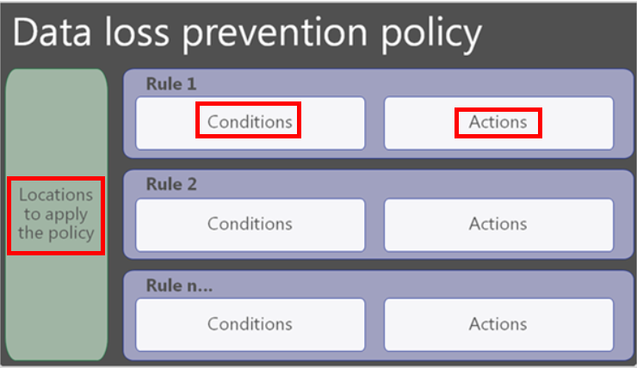
What a DLP Policy Contains
A DLP policy contains a few basic things:
Locations - such as Exchange Online, SharePoint Online, and OneDrive for Business sites
Conditions - for example, look only for content containing Social Security Numbers that have been shared with people outside your organization
Actions – example: block access to the document and send the user and compliance officer an email notification
Notes:
Overview of data loss prevention policies
https://support.office.com/en-us/article/Overview-of-data-loss-prevention-policies-1966b2a7-d1e2-4d92-ab61-42efbb137f5e
A DLP policy can find and protect sensitive information across Microsoft 365, whether that information is located in Exchange Online, SharePoint Online, or OneDrive for Business. You can easily choose to protect all sites or mailboxes, or just specific ones.
Conditions are important because they determine what types of information you’re looking for, and when to take an action. For example, you might choose to ignore content containing passport numbers unless the content contains more than ten such numbers and is shared with people outside your organization.
Conditions focus on the content, such as what types of sensitive information you’re looking for, and also on the context, such as who the document is shared with. You can use conditions to assign different actions to different risk levels -- for example, sensitive content shared internally might be lower risk and require fewer actions than sensitive content shared with people outside the organization.
When content matches a condition in a rule, you can apply actions to automatically protect the document or content.

Slide 40
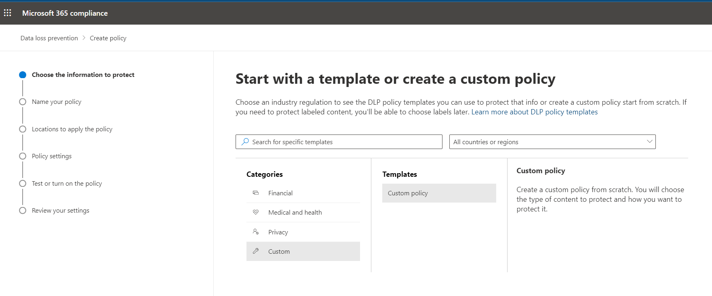
DLP Policy Creation – Use Template or Create Custom?
We provide many templates that cover specific regulations filtered by industry/type and further filter by the specific country/region that they impact.
Custom policies can be made from “scratch” or existing templates can be modified as needed
Use Custom policies if you want to apply DLP using Retention labels
Notes:
Overview of data loss prevention policies
https://support.office.com/en-us/article/Overview-of-data-loss-prevention-policies-1966b2a7-d1e2-4d92-ab61-42efbb137f5e

Slide 41
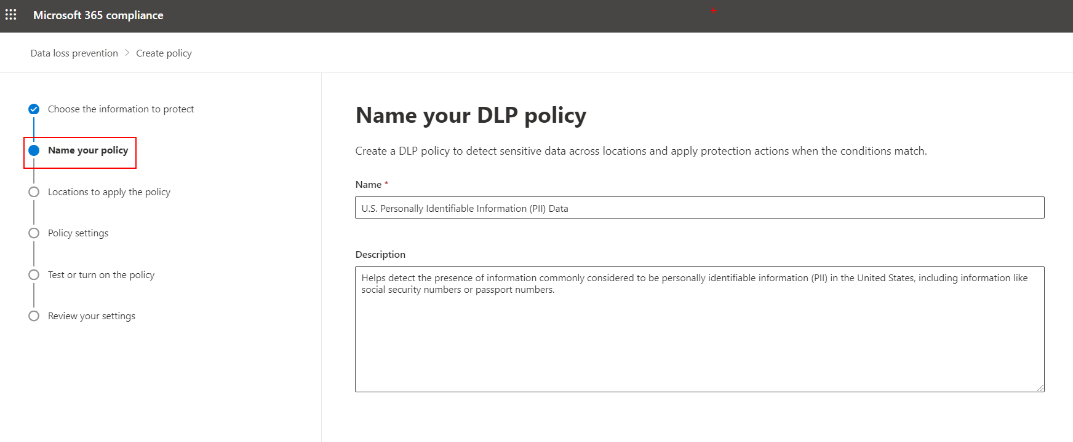
DLP Policy Creation – Name and Description of Policy
Default templates will automatically fill in this information, but custom policies require it be added manually.
Notes:
Overview of data loss prevention policies
https://support.office.com/en-us/article/Overview-of-data-loss-prevention-policies-1966b2a7-d1e2-4d92-ab61-42efbb137f5e

Slide 42
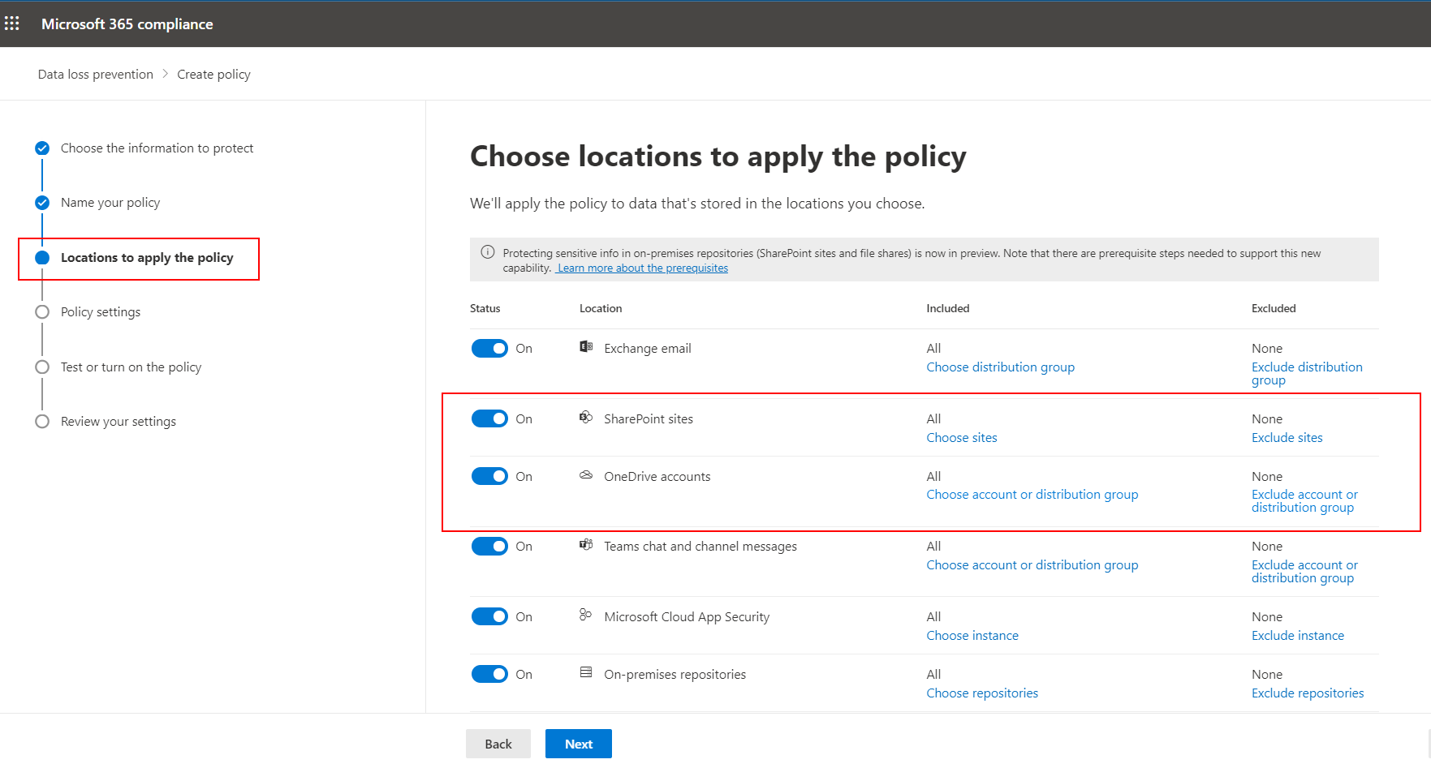
DLP Policy Creation – Select Locations
You can either select all organization locations or select specific locations.
If you select specific location, you will see the screen to the right.
Notes:
Overview of data loss prevention policies
https://support.office.com/en-us/article/Overview-of-data-loss-prevention-policies-1966b2a7-d1e2-4d92-ab61-42efbb137f5e

Slide 43
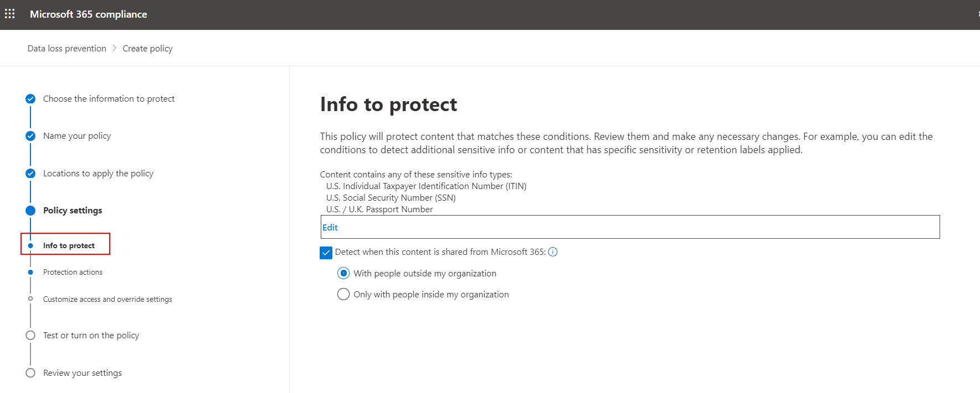
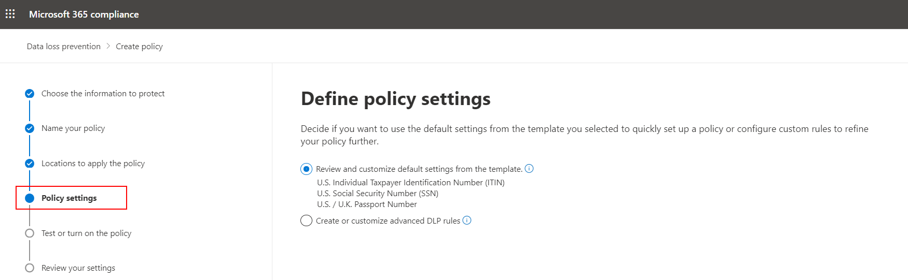
DLP Policy Creation – Policy settings
Specify sensitive information types or retention labels you want to protect
Decide whether you want the policy to detect content shared internally or externally
Notes:
Create, test, and tune a DLP policy
https://docs.microsoft.com/en-us/microsoft-365/compliance/create-test-tune-dlp-policy?view=o365-worldwide

Slide 44
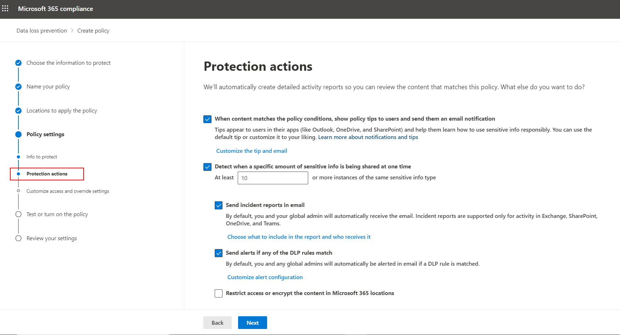
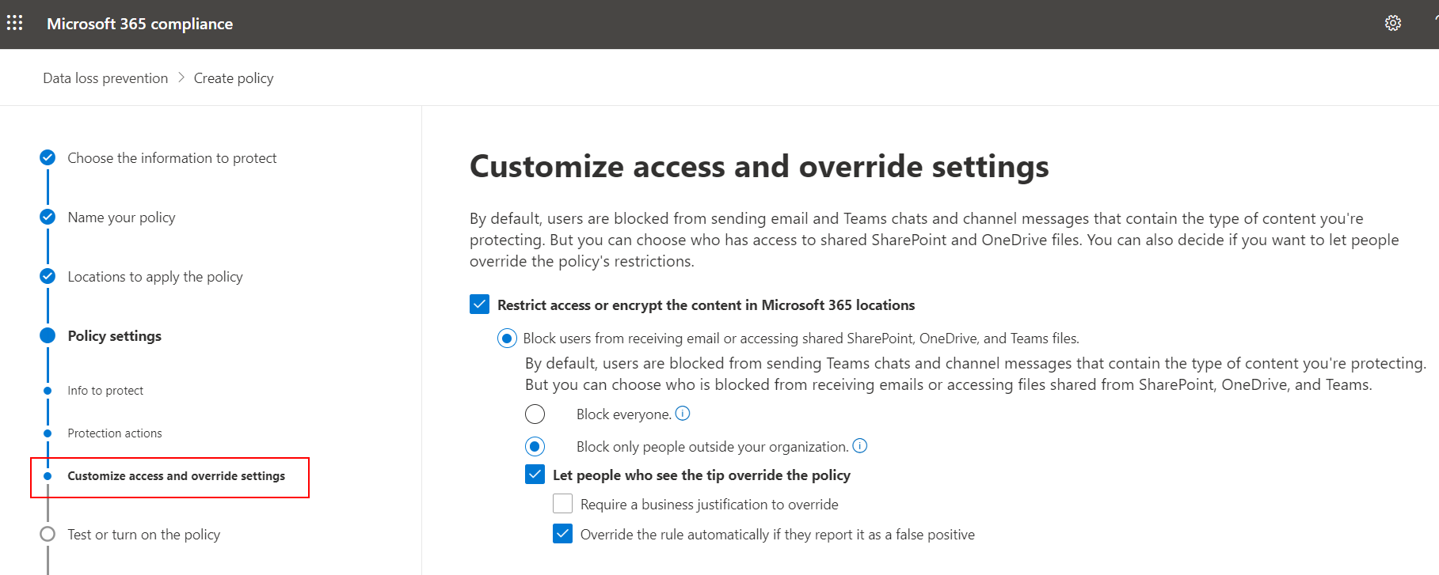
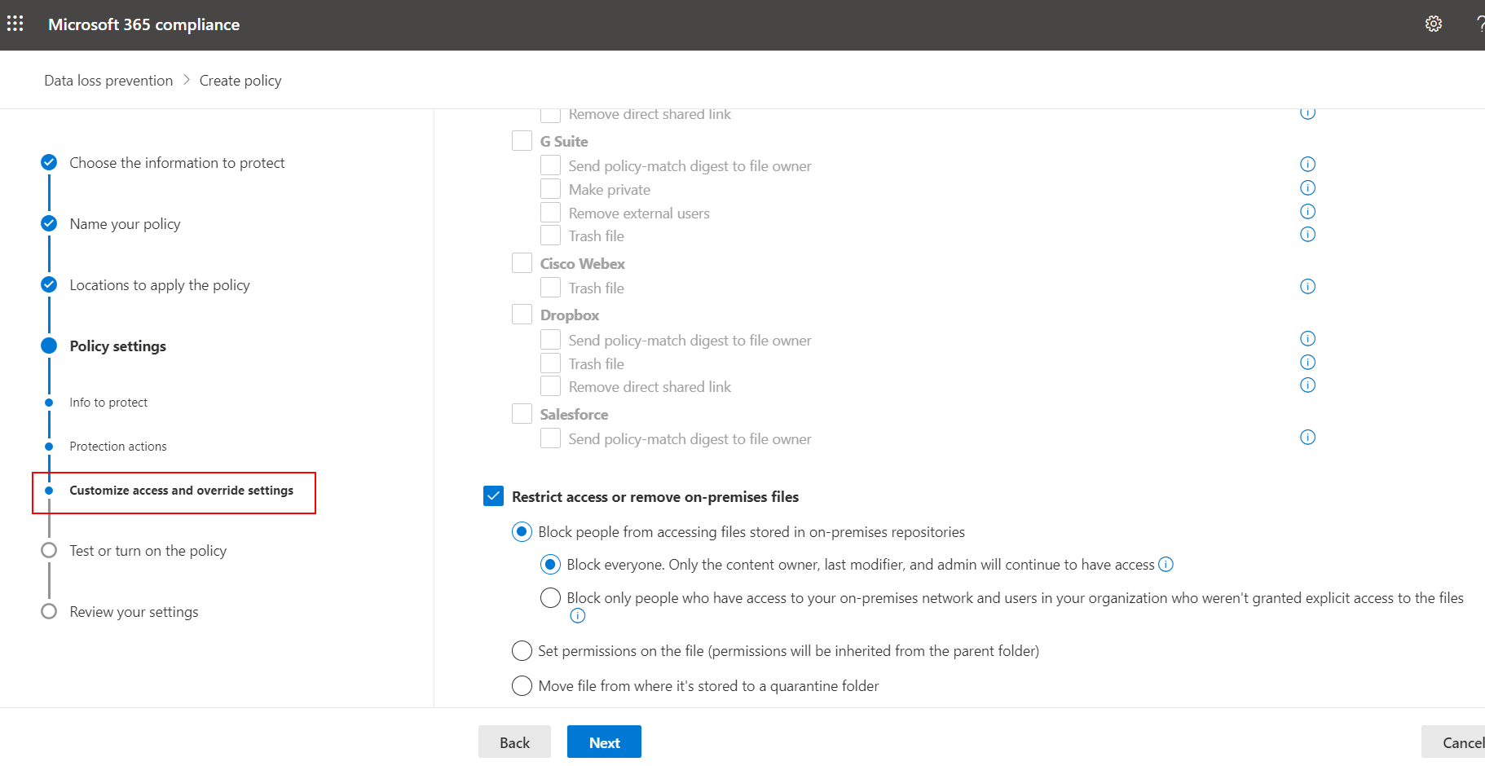
DLP Policy Creation – Policy settings (cont.)
Configure policy tips for end users
Configure who is notified when content matches policy setting
If sensitive information types are used, configure the number of instances of a sensitive info type a piece of content must contain before policy is triggered on that piece of content
Configure to send incident reports in email
And most importantly, configure setting to Block from sharing and restrict access to shared content that matches the policy setting
Notes:
Overview of data loss prevention policies
https://support.office.com/en-us/article/Overview-of-data-loss-prevention-policies-1966b2a7-d1e2-4d92-ab61-42efbb137f5e

Slide 45
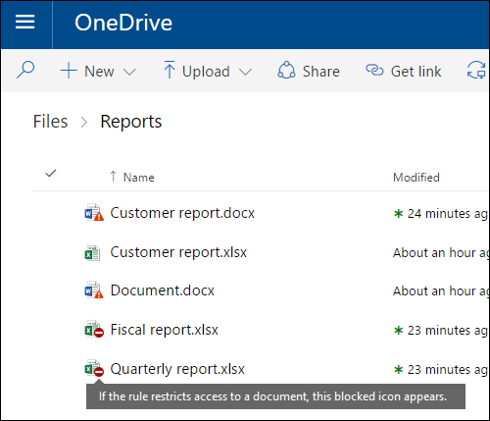
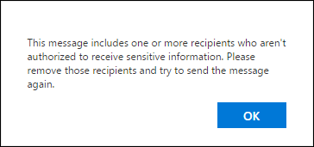
Restrict Access to Content
Site content - if a user tries to share a document containing sensitive information, a DLP policy can both send them an email notification and show them a policy tip
Notes:
Overview of data loss prevention policies
https://support.office.com/en-us/article/Overview-of-data-loss-prevention-policies-1966b2a7-d1e2-4d92-ab61-42efbb137f5e
Restrict access to the content For site content, this means that permissions for the document are restricted for everyone except the primary site collection administrator, document owner, and person who last modified the document. These people can remove the sensitive information from the document or take other remedial action. When the document is in compliance, the original permissions will be automatically restored. When access to a document is blocked, the document appears with a special policy tip icon in the library on the site.

Slide 46
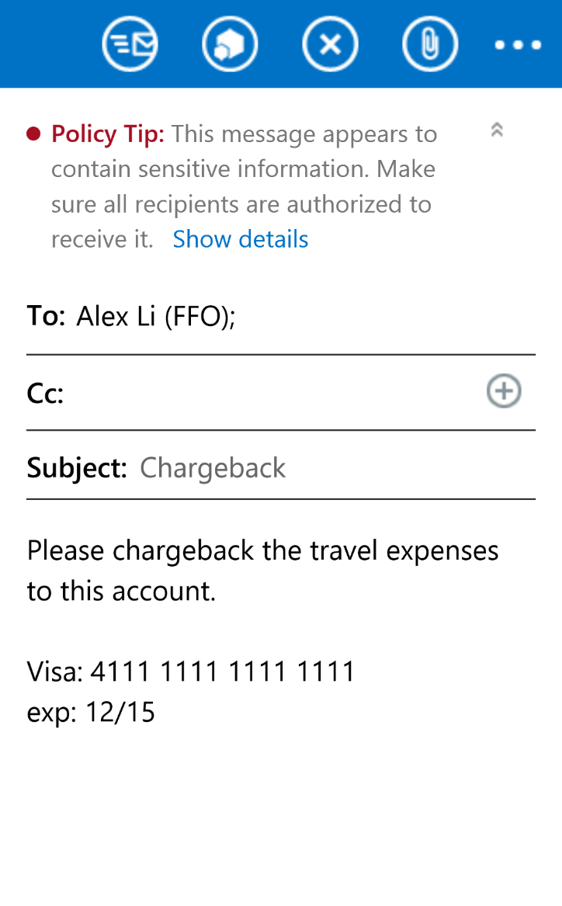
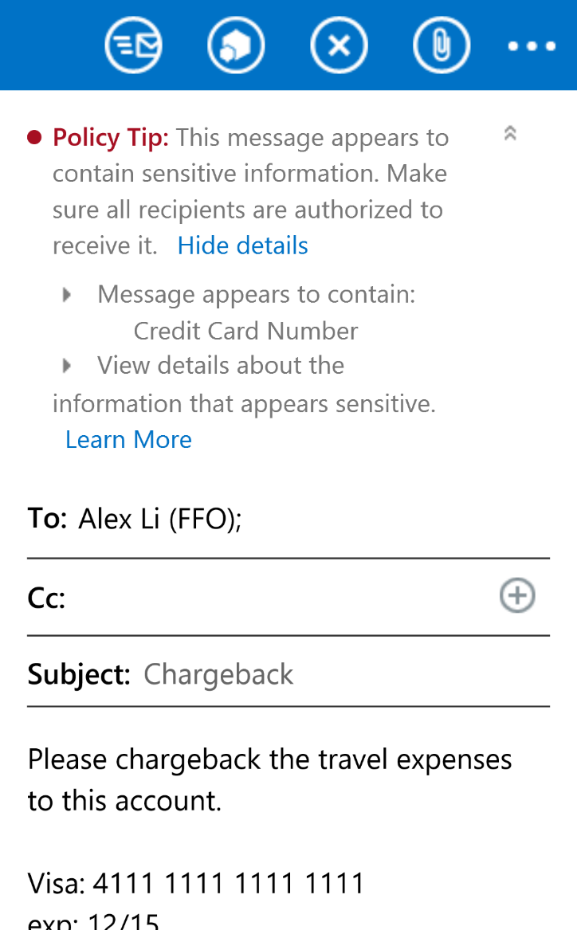
Policy Tips
Customizable notifications to users that they are about to send sensitive content
Workflow can be created based on the different types of sensitive content being sent
Notes:
Policy tips can be used to inform users about the potential of issues within their emails. We can also use them to gather business justifications for their emails, and override any blocks the organization places on them (subject to the policy allowing this).
With respect to policy tips, note that:
Only the policy tip from the highest priority, most restrictive rule will be shown. For example, a policy tip from a rule that blocks access to content will be shown over a policy tip from a rule that simply sends a notification. This prevents people from seeing a cascade of policy tips.
If the policy tips in the most restrictive rule allow people to override the rule, then overriding this rule also overrides any other rules that the content matched.

Slide 47
Key Points
What’s provided with Microsoft 365 E3
Retention/deletion (can include Records enablement) policies
RMS/AIP Information Rights Management implemented via SharePoint Online document library and/or content types
DLP polices
What’s provided in Microsoft 365 E5 (in addition to above)
Auto-apply Retention labels
What’s provided in Azure Information Protection P1 (in addition to O365 E3/E5)
Sensitivity labels (manual application)
What’s provided in Azure Information Protection P2 (in addition to O365 E3/E5)
Sensitivity labels (auto-apply via conditions based on sensitive data types)

Slide 48
Knowledge Check
After creating a new Sensitivity label, what must be done before the label becomes visible and available to users?
What is the license requirement to Auto-apply Sensitivity labels?
What service must be enabled at the tenant level before using Azure Informtion Protection?
The label must be published
E5
The RMS/AIP subscription
M365 E5/A5 Compliance license, or + M365 E5/A5 Info Protection & Governance
Notes:
1. What is the license requirement to Auto-apply Retention labels?
Answer: O365 E5, M365 E5/A5 Compliance license, or + M365 E5/A5 Info Protection & Governance
What is the license requirement to Auto-apply Sensitivity labels?
Answer: O365 E5 + Azure Information Protection P2
3. What service must be enabled at the tenant level before using Azure Informtion Protection?
Answer: The Azure Rights Management Service (RMS)

Slide 49
Summary
In this lesson, you learned how to:
Configure and use Retention policies, Labels (sensitive and retention labels), and Data Loss Prevention policies, to provide addition layers of data security, protection, and governance, of content stored in SharePoint Online and OneDrive for business.

